Slide 1
OSCE Question
7-6-2017
YCH

Slide 2
Question 1
53/ F
Dizziness and vomiting
Hx of DM, HT, gallstones , renal impairment
BP 90/54 P 80

Slide 4
a/ What are the ECG findings?
b/ What is the diagnosis?
c/ How would you manage the patient?
d/ What is the probable underlying cause?

Slide 5
Question 2
27/F, Good Past health
dizziness, limbs twitching while on duty
On Arrival
GCS E4V1M5
R eye deviated to Right, drooling saliva

Slide 6
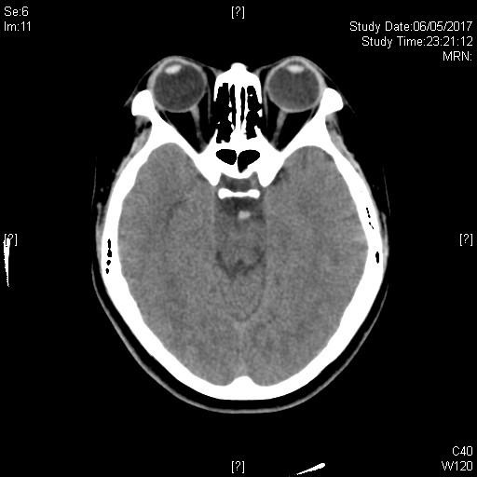
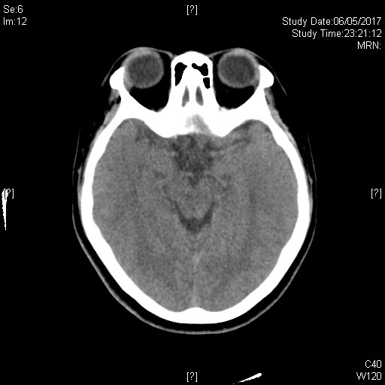
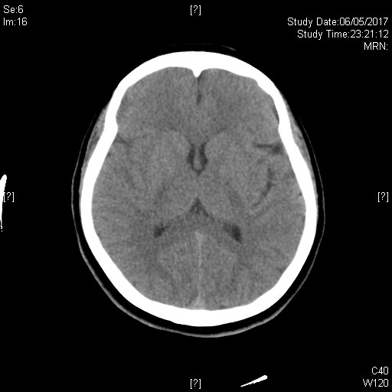

Slide 7
a/ What is the CT finding?
b/ What is the diagnosis?
c/ How would you manage the patient?

Slide 8
Question 3
25/ M
S/F with R hand contusion
T+ swelling over radial side of right hand

Slide 10
a/ What is the x ray finding and diagnosis ?
b/ What is the associated injury ?
c/ How would you manage the patient?

Slide 11
Question 4
56/F
sudden onset floater and flashing of right eye
Bedside USG of right eye was performed

Slide 13
a/ What is the USG finding(s) ?
b/ What is the diagnosis?
c/ How would you manage the patient?

Slide 14
Question 5
40/M
LBP x few months
No Hx of injury

Slide 15
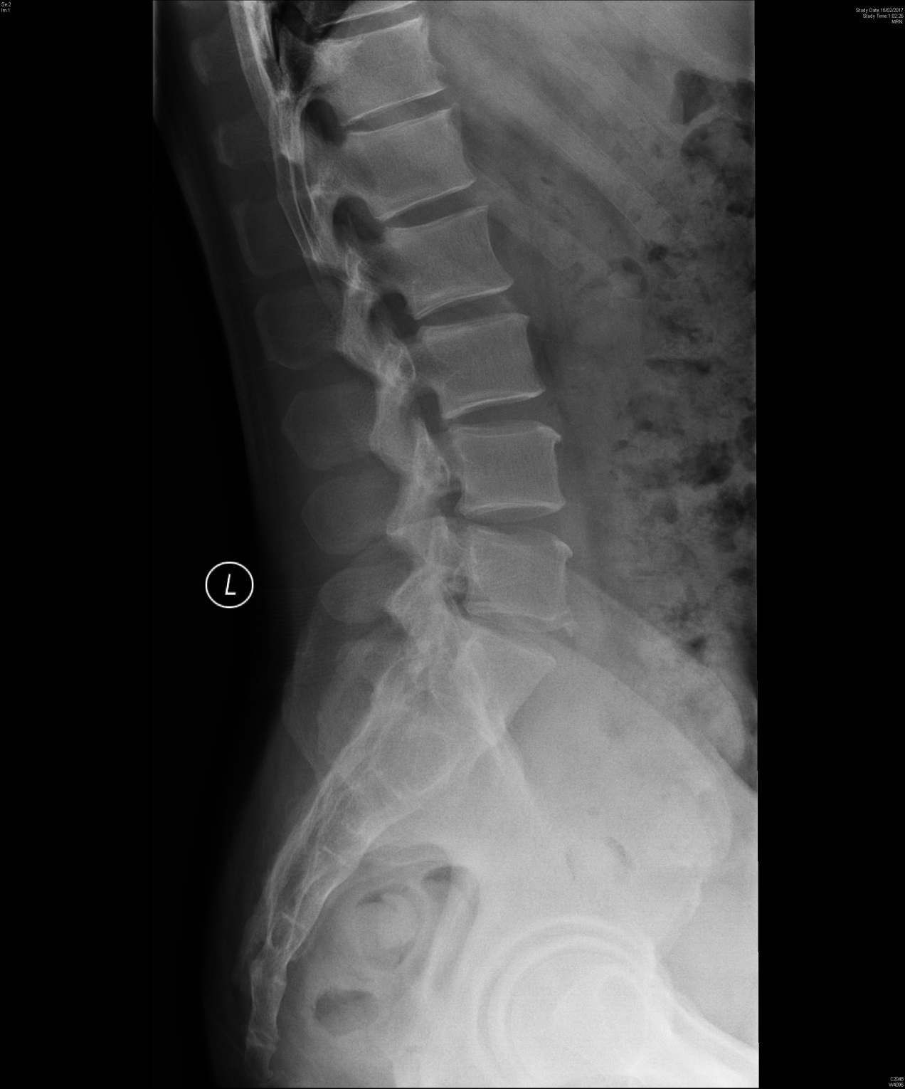

Slide 16
a/ What are the x ray findings?
b/ What is the diagnosis?
c/ What associated feature(s) you would look for?
d/ How would you manage the patient?

